Slide 2
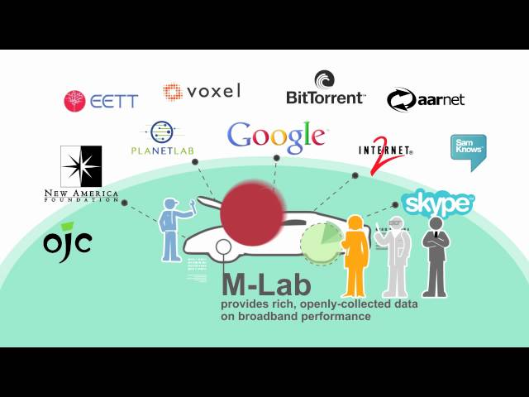
Measurement Lab

Slide 3

What is M-Lab?
An open,
distributed server platform
for high-fidelity network measurement.

Slide 4

M-Lab Provides...
Researchers:
Global testing capacity
Regulators:
Data about regional network health
Users:
High-fidelity, real-world measurement of their connection
Opt-in crowdsourcing

Slide 5
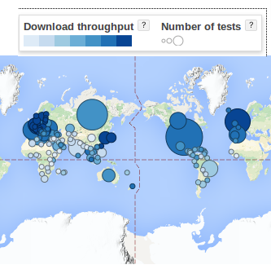
M-Lab’s Goal:
Enhance Internet transparency to
sustain a healthy, innovative Internet.

Slide 6
With minimal cost, M-Lab provides:
Open, verifiable, public measurement data and tools, that have been developed and tested by the field’s leading experts
Facts at scale 800+ terabytes of public, verifiable data, and growing.
Open, global infrastructure designed and managed specifically for measurement

Slide 7
Why is openness important?
The Internet is vast, decentralized, and dynamic.
Measuring Internet performance is a complicated science.
Complicated science requires collaboration, peer review, and above all, replicable results. Openness makes this possible.
M-Lab’s open data provides a valid, trusted source of information used globally by regulators and researchers.

Slide 8
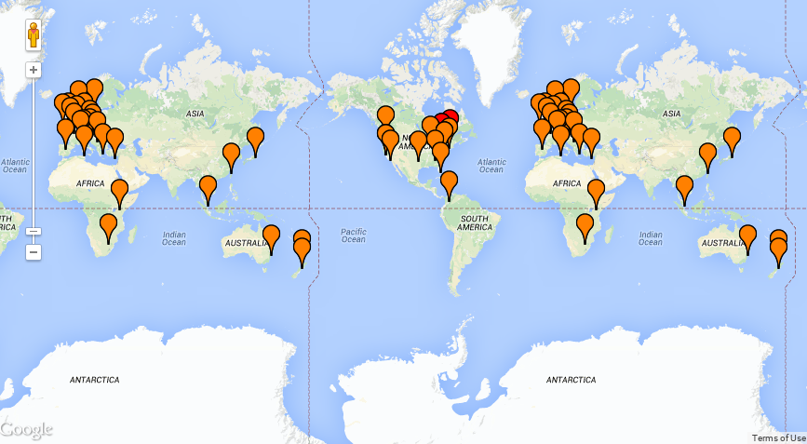
So, what is it?
Hundreds of servers running twelve network experiments
927 Terabytes of publicly accessible data
100% open source
Notes:
Ok. So, what is M-Lab again? :)
hundreds of servers on all inhabited continents
twelve network measurement experiments produced by independent academic and industry researchers
What are the latest stats?
338.28 million tests to date
250K test per day (check and update)
500GB of data per day
927 Terabytes of data (TB)

Slide 9

M-Lab: a diverse global partnership supporting open network research

Slide 10
What M-Lab can do for you
Robust, , field-tested measurement system
Depth and breadth of data allows for comparisons at ISP, regional, national, and international levels

Slide 11
2. What data does M-Lab collect?

Slide 12
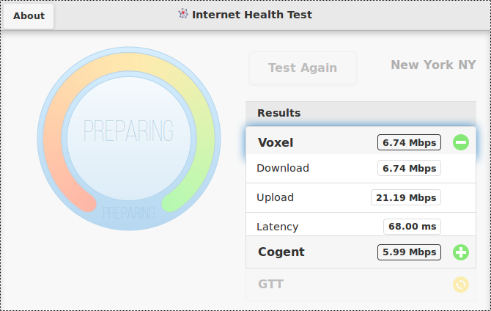
What’s in the Data
Download Throughput
Upload Throughput
Latency
Packet Retransmission Rate
Minimum Round Trip Time
Average Round Trip Time
Notes:
the complete set of NDT variables is available

Slide 13




Performance Tests
NDT
Test your connection speed and receive sophisticated diagnosis of problems limiting speed.
Neubot
Performs periodic tests to measure network performance and traffic throttling.
NPAD (Network Path &amp; Application Diagnostics)
Diagnose common problems that impact last-mile broadband networks.
MobiPerf
MobiPerf is an application for measuring network performance on mobile platforms.
Notes:
http://www.measurementlab.net/tests

Slide 14



Transparency tests
OONI Probe
The Open Observatory for Network Interference measures specific use cases of network interference.
ShaperProbe
ShaperProbe detects whether your ISP performs traffic shaping.
Glasnost
Test for application-specific blocking or throttling.
Neubot
Performs periodic tests to measure network performance and application-specific traffic throttling.

Slide 15
M-Lab's diverse suite of tools
12 tools, more on the way
Browser-based NDT, Glasnost, Shaperprobe, Neubot, and more
Hardware-based BISmark, SamKnows
Mobile MobiPerf, NDT, more on the way
Multiple vantages and methodologies provide important layers of meaning. There is no one way to measure. The key to any choice is to ensure that it's open and verifiable.
Notes:
Delete this slide?

Slide 16
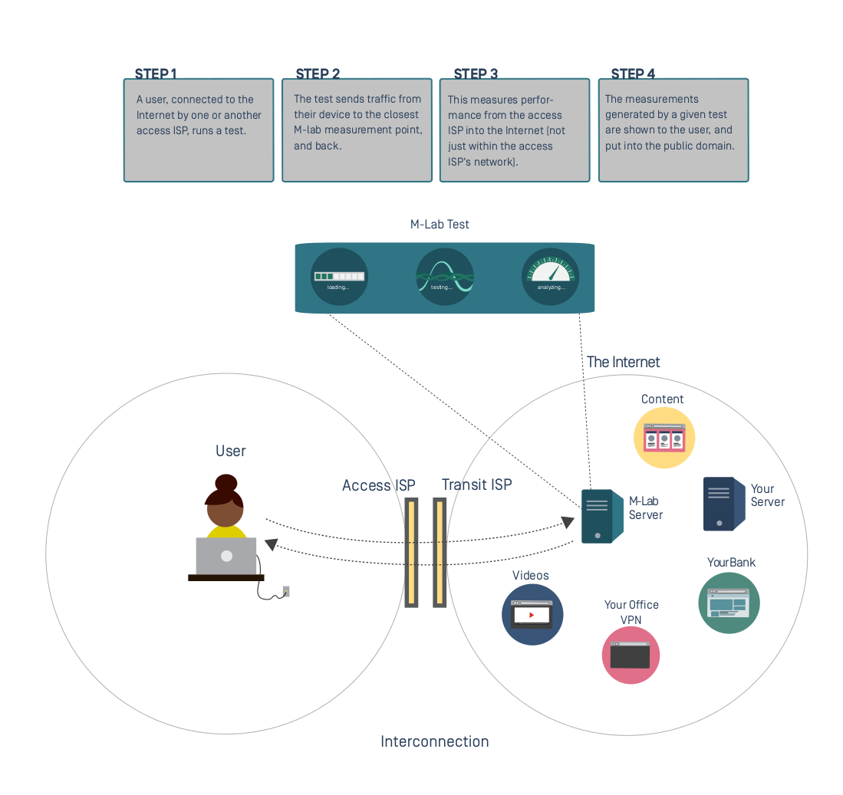
3. How does M-Lab collect data?

Slide 17
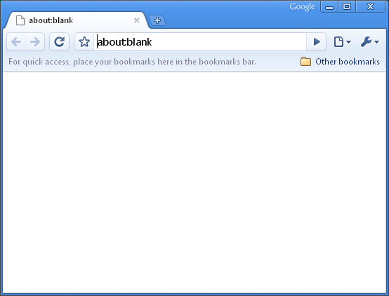











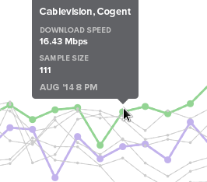
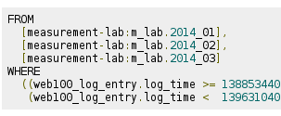
High level overview M-Lab platform
Internet User
Researcher
Regulator
Journalist
Developer
visualizations
data & APIs
Cloud Storage
raw data
BigQuery

Slide 18
NDT demo

Slide 19
4. Data storage + retrieval
- Flow diagram - Examples for the data of two tools - Demos of PDE, Telescope, BigQuery

Slide 20
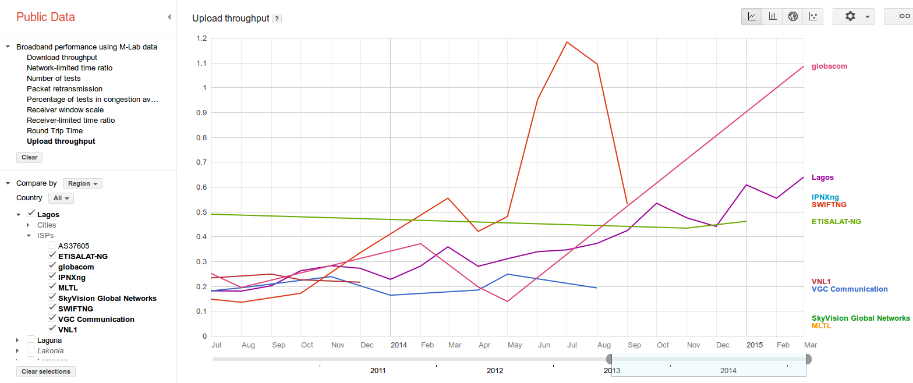
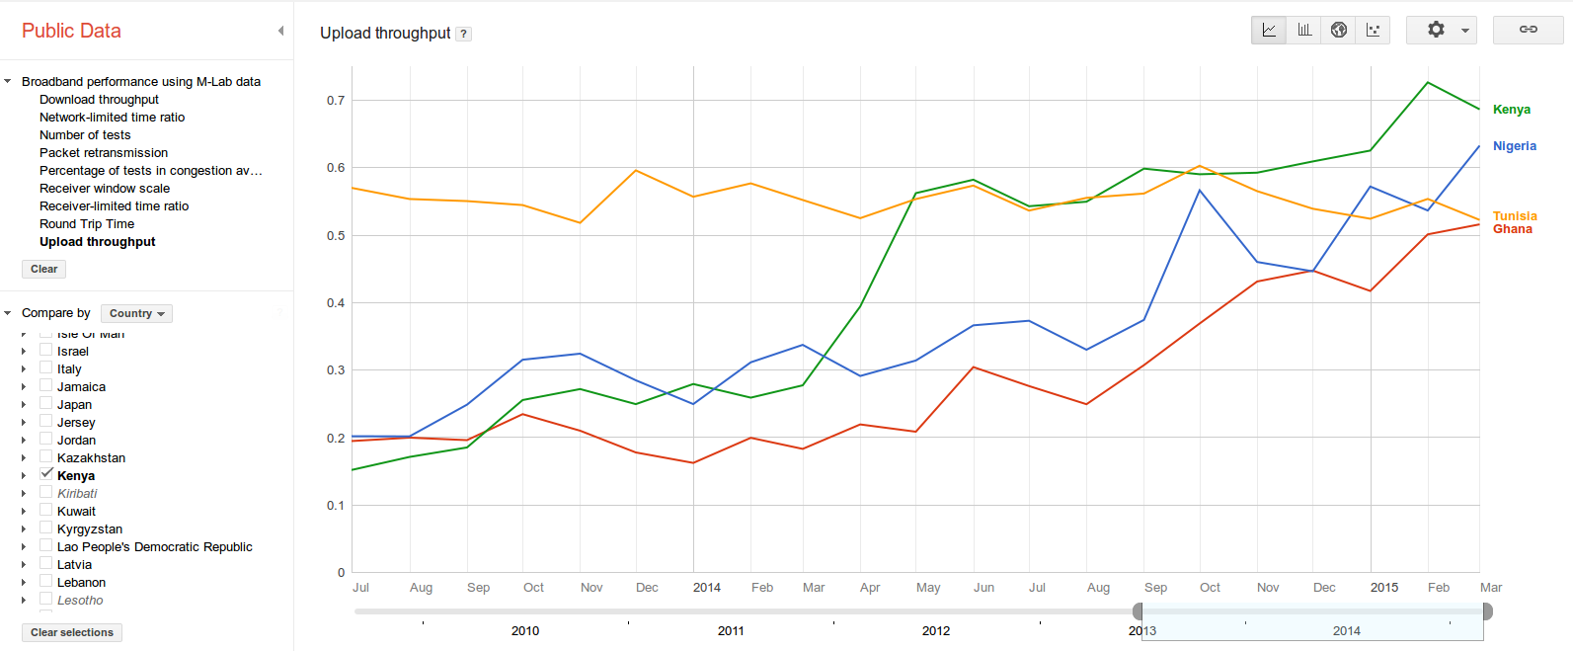

Slide 21
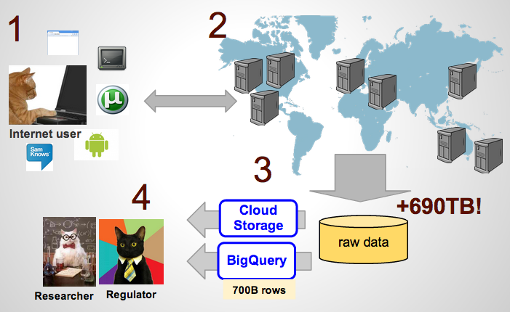
How does it work? An open measurement ecosystem

Slide 22
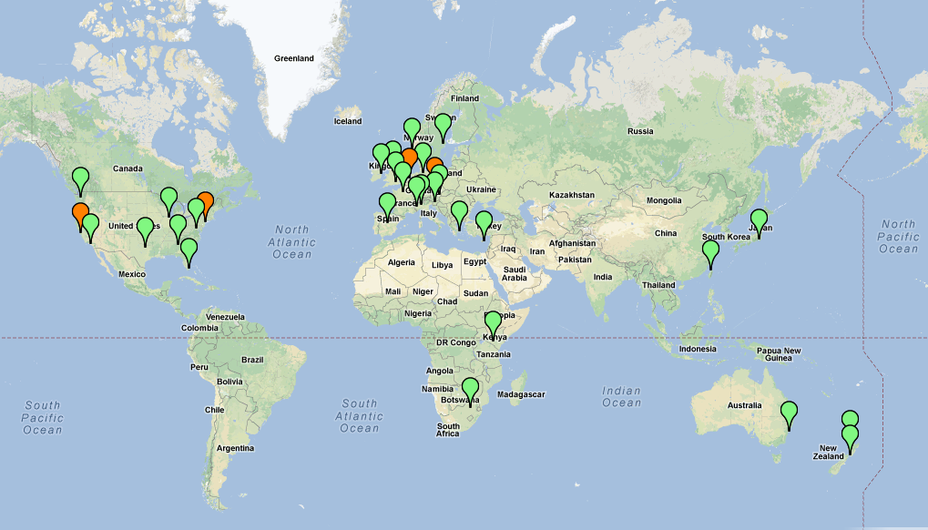
M-Lab’s global server platform means global data
100+ global servers, and growing. A bird's eye view:

Slide 23
Regulatory partners
Austria, RTR Mobile tool using NDT, supporting M-Lab servers
Cyprus, OCECPR Adopting Hyperion dashboard, supporting M-Lab servers
European Commission SamKnows study running on M-Lab
Greece, EETT Hyperion dashboard using M-Lab's NDT and Glasnost tools, supporting M-Lab servers
Thailand, NBTC Initial stages, supporting M-Lab servers to gather open data
US, FCC Consumer Broadband Test, Measuring Broadband America report

Slide 24
6. How regulators, etc. can use data
Greek Regulator portal:
URL: http://hyperiontest.gr/
Source code: https://github.com/eett/hyperion-NDT
Architecture: PHP/mysql
New Zealand portal: (NGO)
URL: http://nzbt.org.nz/
Source code: https://github.com/rabid/nzbt
Architecture: Ruby on Rails
Canadian (CIRA):
URL: http://performance.cira.ca
Source code: not yet available
Austria portal:
URL: https://www.netztest.at/en/
Source code: Not yet available
The Interconnection Report

Slide 25

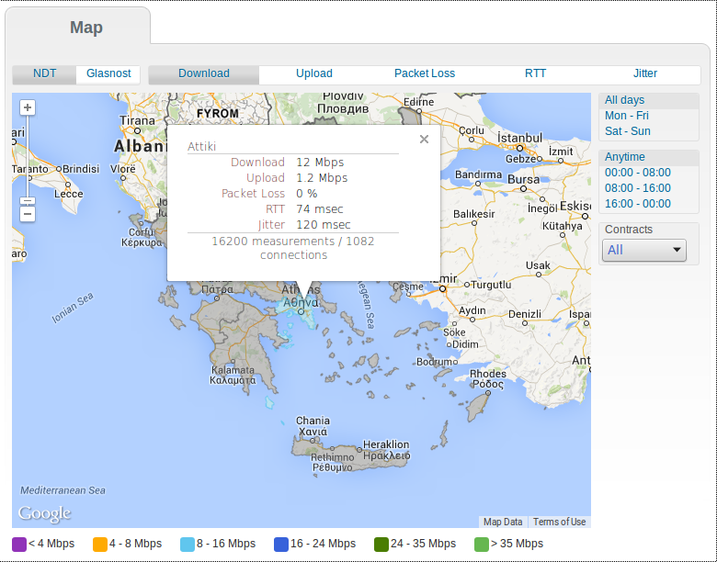
Greece’s Regulatory Portal
http://hyperiontest.gr/
https://github.com/eett/hyperion-NDT

Slide 26
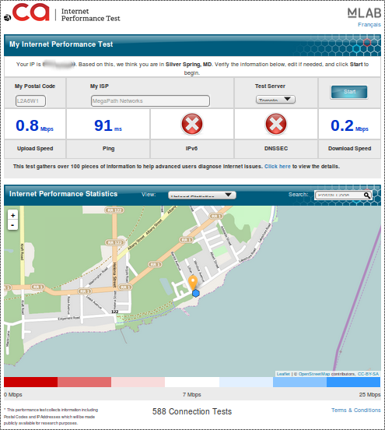
CIRA
(Canadian
Internet
Registration
Authority)

Slide 27
How can you get involved?
Join 6 National regulators and many others in partnering with M-lab. Host servers, use M-Lab tools to measure national performance.
Engage with university researchers to answer your questions openly, using open data.
Engage citizens to measure their network performance using M-Lab’s open tools. They get real results, you get the benefit of reliable data on which good policy can be based.

Slide 28
Contribution matrix: what is already covered
Contribution | Requirement | Cost to you | Responsible party
Manage and maintain global servers | Full time staff of experts managing global server platform | $0 | M-Lab Consortium
Develop and maintain state of the art open source measurement tools | Network experts developing using tools that measure Internet performance at scale | $0 | M-Lab Consortium researchers
Store and make available collected data | Provide storage of and access to large cache of measurement data collected by M-Lab | $0 | M-Lab data hosting partners
Provision servers | Provide suitable server hardware to interested hosts (3 servers and 1 switch) | $0 | M-Lab Consortium

Slide 29
Contribution matrix: what you would contribute as an M-Lab partner
Role | Requirements | Responsible Party
Rack space | 6U Rack Space | Host
Power | (700 Watts*4) Power requirement might differ with server specification | Host
Transit Bandwidth | 100Mbps dedicated capacity (with 1G burst capacity). | Host / Third Party support

Slide 30
7. Examples / case studies of full analyses
- Iran - U.S. Interconnection study - Glasnost?

Slide 31
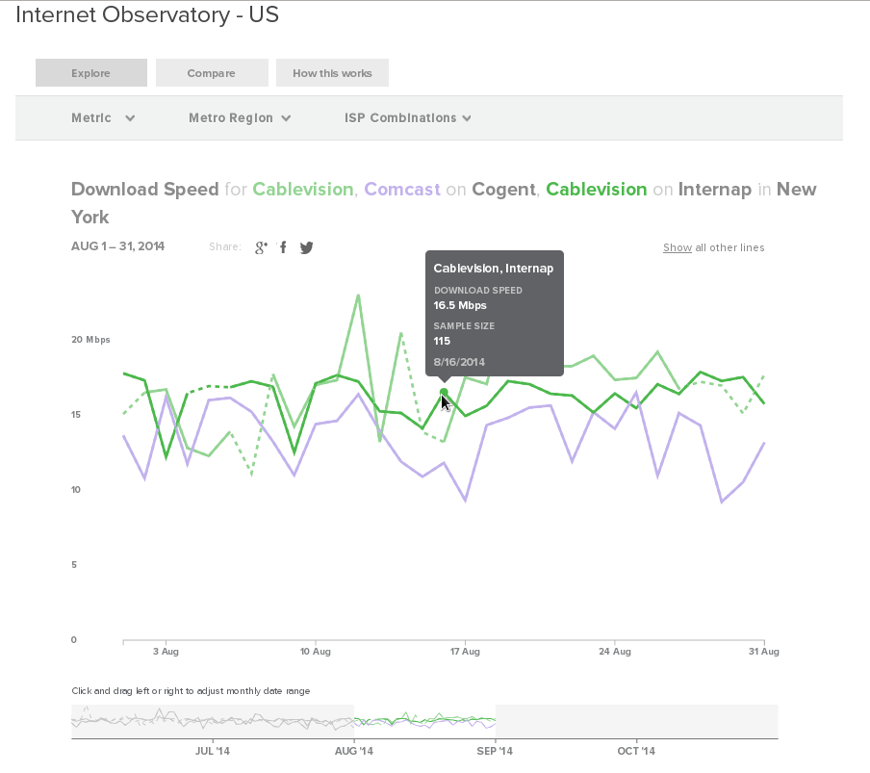
Recent Research and Visualizations
ISP Interconnection and its Impact on Consumer Internet Performance
http://www.measurementlab.net/publications
Internet Observatory Visualization
http://www.measurementlab.net/observatory
Collaboration with Greta Byrum on CONFINE
Censorship measurement convenings with research community
Notes:
The recent publication of the Interconnection report and Observatory visualization is exemplary of the kind of work M-Lab will be doing more of in the future-- open tools for more audiences to use our data

Slide 32
Who Does What?
OTI
Platform operations and maintenance
Policy
Technical R&D (support for experiments)
Google
Data collection pipeline
Hardware provisioning and support
Technical R&D (support for experiments)
Experiment Partners
Design and implement tests
Hosting Partners
Provide space and power for servers

Slide 33
8. Brainstorming relevant local analyses and applications

Slide 34
The Last Slide
Should have the stuff that we want people to remember

Slide 35
What is M-Lab?
An open, distributed server platform on which researchers can deploy active, client-server network measurement tools that measure aspects of broadband Internet connections.
M-Lab’s Goal:
To advance research and empower the public with useful information about their broadband connections.
By enhancing Internet transparency, we aim to help sustain a healthy, innovative Internet.

